Slide 1
Presentation title to go here
Harnessing microbiology to tackle global challenges

Slide 2
Presentation title to go here
Harnessing microbiology to
tackle global challenges

Slide 3
Our Mission and Vision
Showcasing the work from over 100 microbiology research groups at Norwich Research Park – one of the world’s largest sites for microbiology
Promoting, advertising and driving high-quality microbiology research and innovation to address global challenges in food security, human health and climate change
Fostering collaboration within and beyond Norwich Research Park to provide a vehicle for large-scale funding bids, impacts on policy and increased recruitment of staff and students
Contact:
Sam Rowe
sam.rowe@quadram.ac.uk
Norwich Research Park
Norwich
NR4 7UG
United Kingdom
www.cmi-norwich.ac.uk
X/Twitter: @MicroNorwich

Slide 4
Centre for Microbial Interactions
Showcasing the work from over 100 microbiology research groups at Norwich Research Park – one of the world’s largest sites for microbiology
Promoting, advertising and driving high-quality microbiology research and innovation to address global challenges in food security, human health and climate change
Fostering collaboration within and beyond Norwich Research Park to provide a vehicle for large-scale funding bids, impacts on policy and increased recruitment of staff and students
Contact:
Sam Rowe
sam.rowe@quadram.ac.uk
Norwich Research Park
Norwich
NR4 7UG
United Kingdom
www.cmi-norwich.ac.uk
X/Twitter: @MicroNorwich

Slide 5
Centre for Microbial Interactions
Showcasing the work from over 100 microbiology research groups at Norwich Research Park – one of the world’s largest sites for microbiology
Promoting, advertising and driving high-quality microbiology research and innovation to address global challenges in food security, human health and climate change
Fostering collaboration within and beyond Norwich Research Park to provide a vehicle for large-scale funding bids, impacts on policy and increased recruitment of staff and students

Slide 6
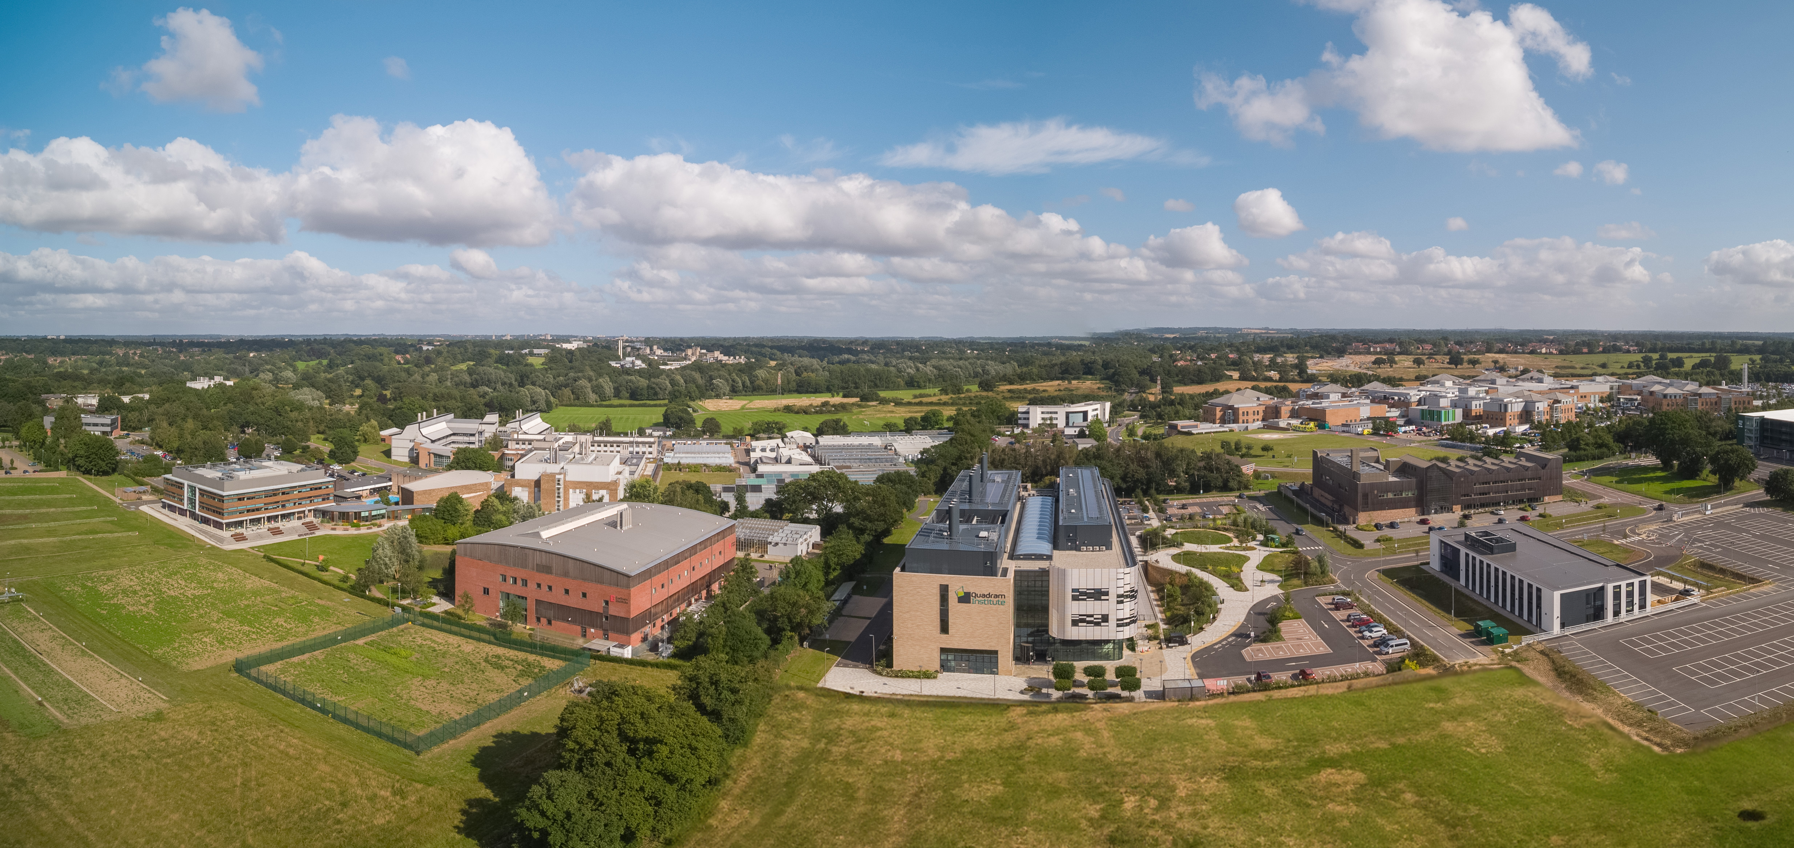
A unique cluster of world class institutions all located within 1 km²

Slide 7
This is a section title
This is a section subtitle

Slide 8
A title of sorts
A bullet
A line of copy

Slide 9
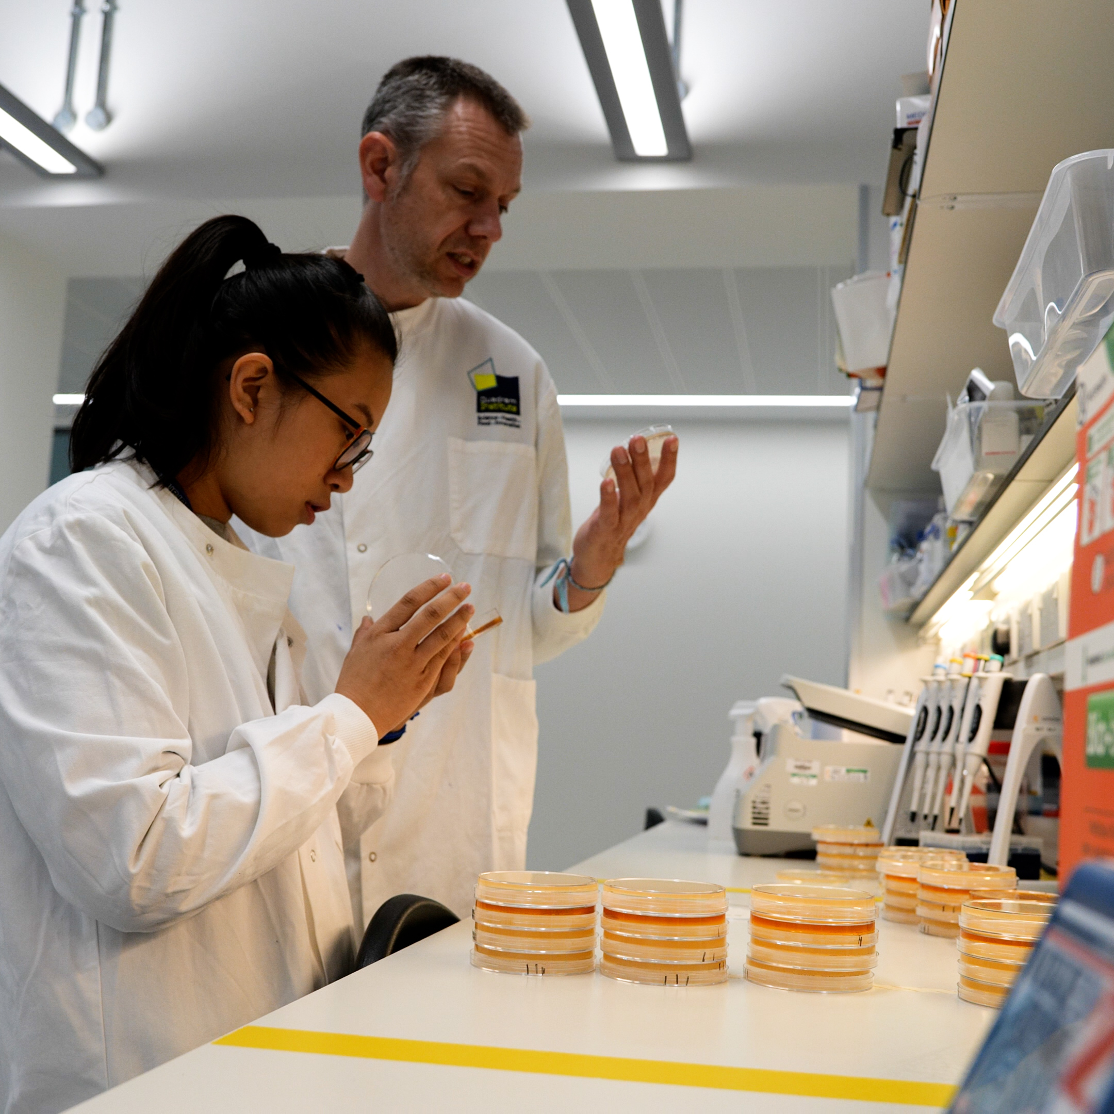
A title of sorts
A bullet
A line of copy

Slide 10
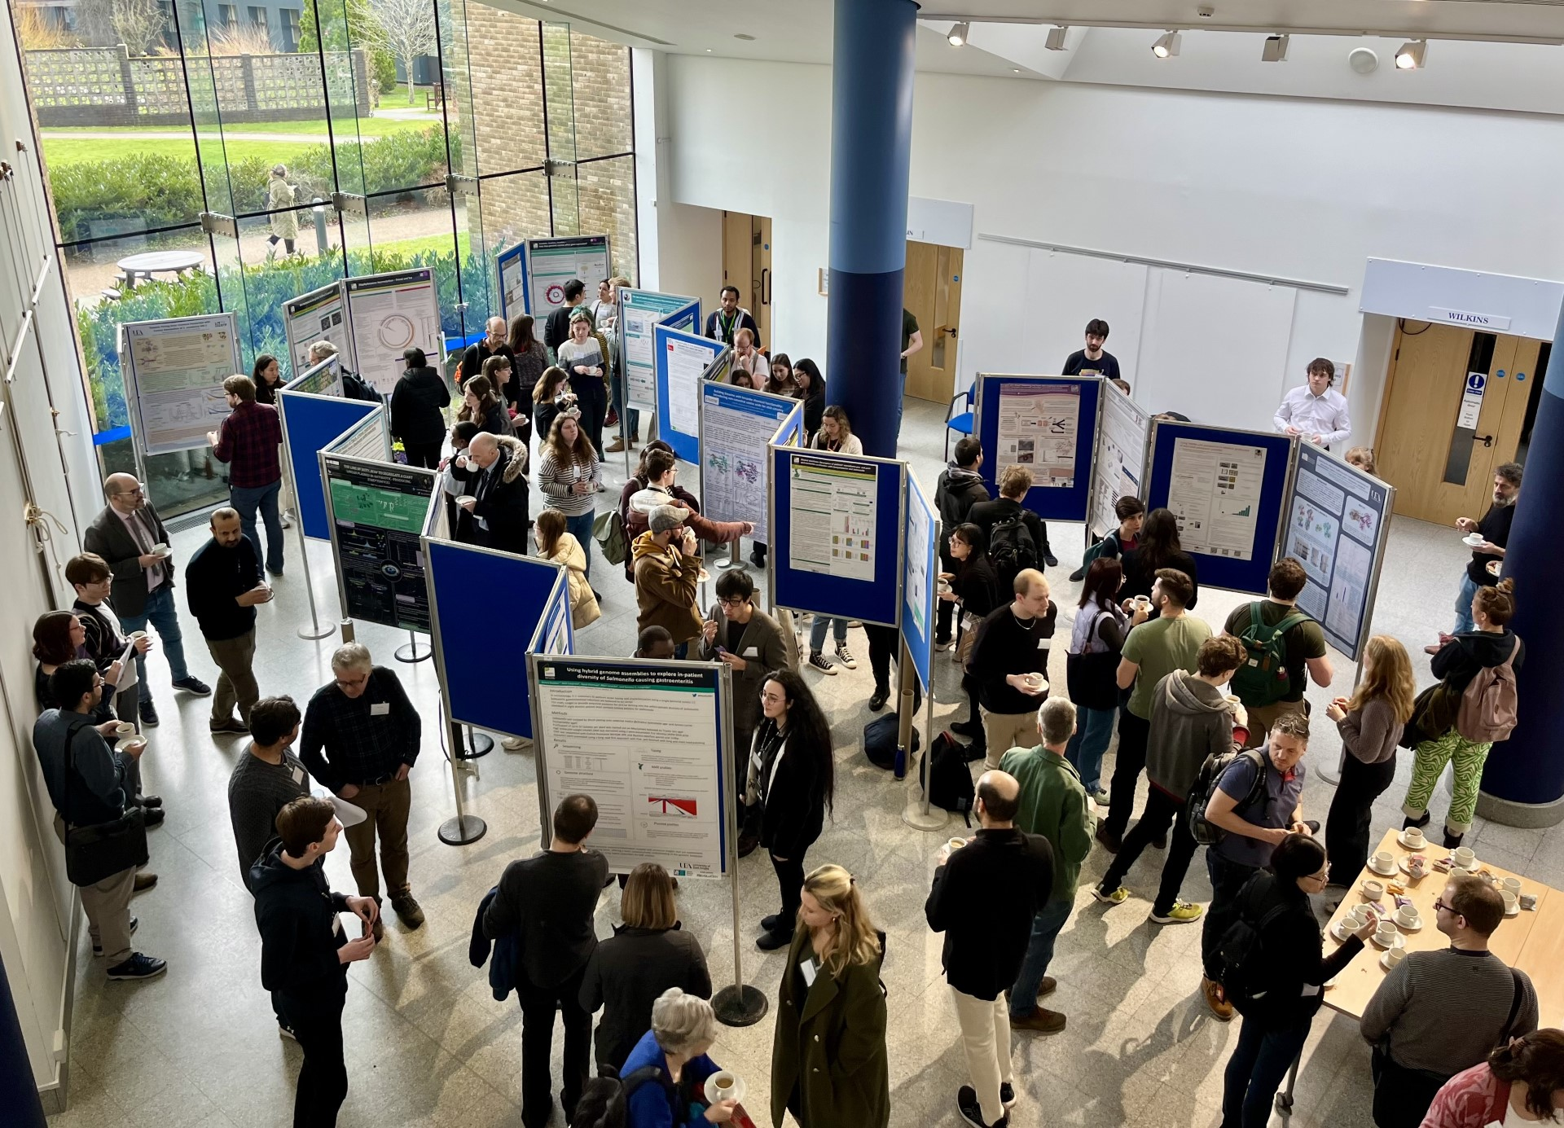
A title of sorts
A bullet
A line of copy

Slide 11
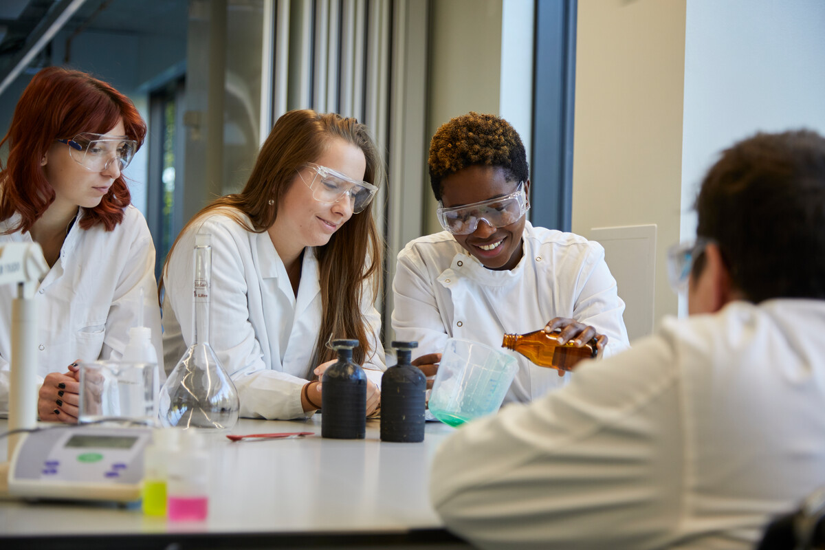
A title of sorts
A bullet
A line of copy

Slide 12
With thanks
Contact:
Sam Rowe
sam.rowe@quadram.ac.uk
Norwich Research Park
Norwich
NR4 7UG
United Kingdom
www.cmi-norwich.ac.uk
X/Twitter: @MicroNorwich

